Slide 1
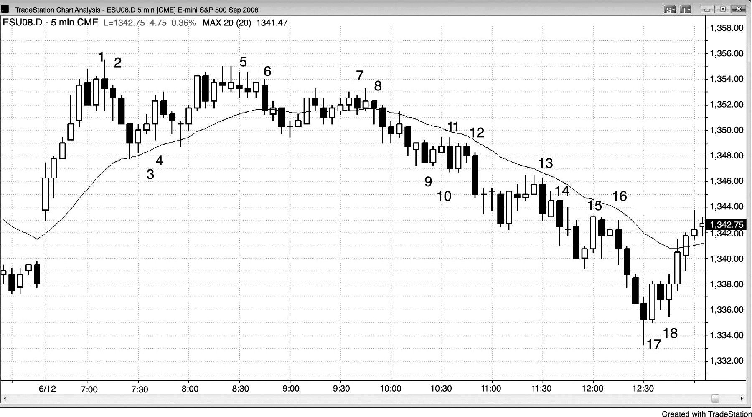
FIGURE 10.1 Second Entries

Slide 2
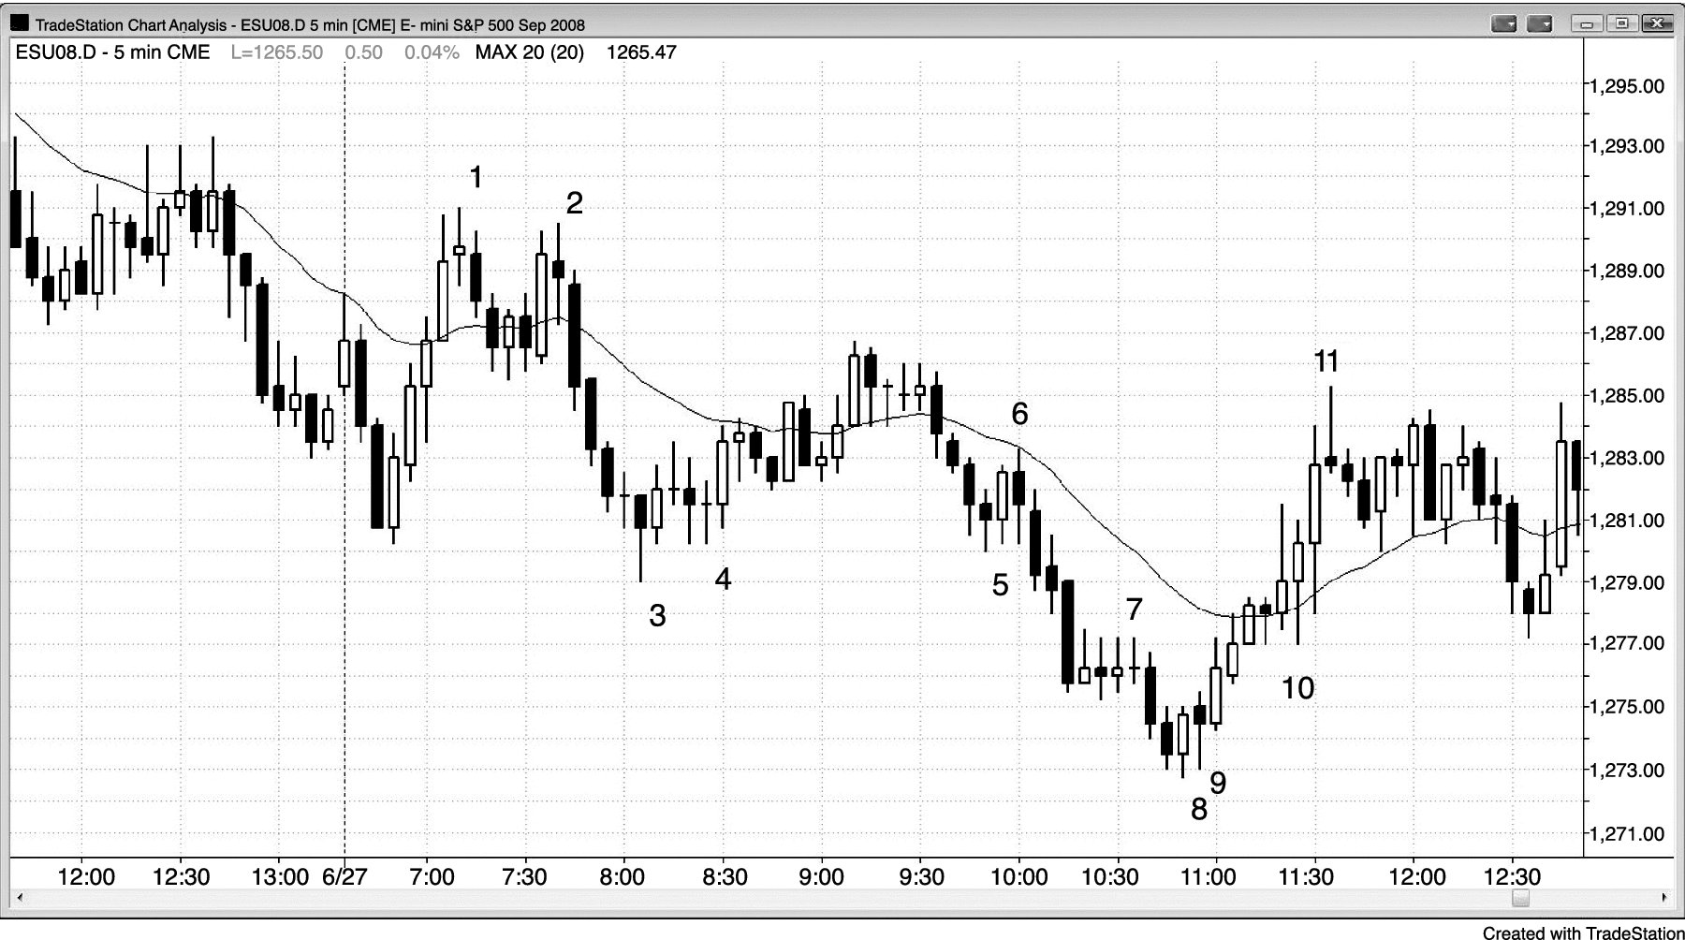
FIGURE 10.2 In Strong Moves, Wait for Second Reversals

